Slide 1
Testing the hypothesis that something important happened
Gemma Wallace & Neil Yetz
PSY 653 Module 11 Lab
Apr 22, 2020

Slide 2
Goals for this activity:
Practice identifying minimum effects for rejecting specific hypotheses
Using the sleep hygiene data, conduct regular and Bayesian ANOVAs to determine whether gender and occupation are related to mental health
Interpret and compare results from the two analytic approaches
Though not shown in the demo, remember that it’s best practice to examine descriptives and visualize your data before conducting analyses :)

Slide 3
Part 1: Minimum effects practice

Slide 4
Minimum Effects Testing (MET)
It tests the hypothesis that the effect of treatments falls somewhere in an interval between zero and some number
Rather than testing if an effect is precisely zero, we can test if it falls above a range of values (The minimum effect you are testing)

Slide 5
The authors used Right Wing Authoritarianism (RWA) to predict differences in response time to in-group and out-group faces, and found a squared correlation of .07, which was significant, with F(1,161) = 4.81

Slide 6
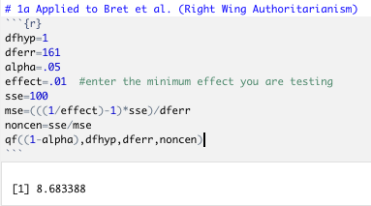
Identifying minimum effects: Kevin’s minimum effects code
F(1,161) = 4.81,
𝝰 = .05,
Minimum effect = 1%
Don’t change

Slide 7
Detecting minimum effects: Kevin’s minimum effects code
F(1,161) = 4.81
Compare the resulting minimum F-value needed to test an effect of 1% or more to the obtained F-value.
In this case we did NOT reach the threshold F-value to have a significant effect at 1%. The authors need an F-value of 8.68 to obtain a significant effect at a minimum effect of 1%.

Slide 8
Identifying minimum effects via Murphy, Myors & Woloch (2014) “One Stop” F-table (Appendix B)

Slide 9
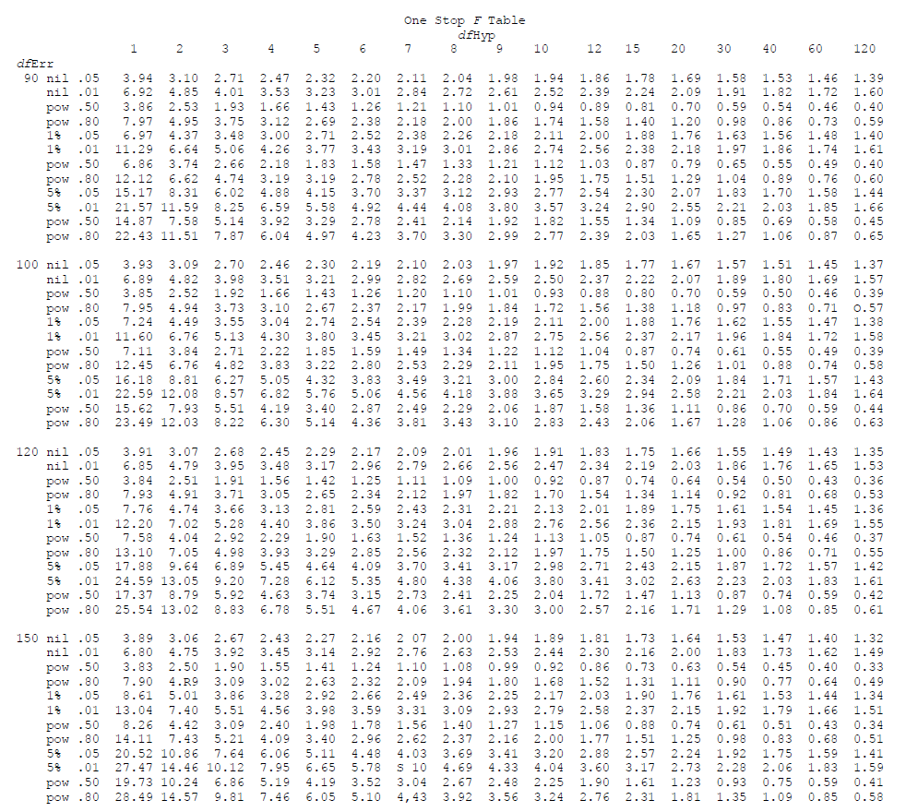
Minimum F required (Appendix B)
Comparison to a Nil effect
With a DF_{hyp} = 1 and DF_{err} = 161, the Authors need an F-value of 3.89 or more to obtain a significant effect.
Obtained F = 4.81
We have a significant effect

Slide 10
Minimum F required (Appendix B)
Comparison to a 1% effect
With a DF_{hyp} = 1 and DF_{err} = 161, the Authors need an F-value of 8.61 or more to obtain a significant effect.
Obtained F = 4.81
We do NOT have a significant effect

Slide 11
Identifying minimum sample size via Murphy, Myors & Woloch (2014) “One Stop” PV-table (Appendix C)

Slide 12
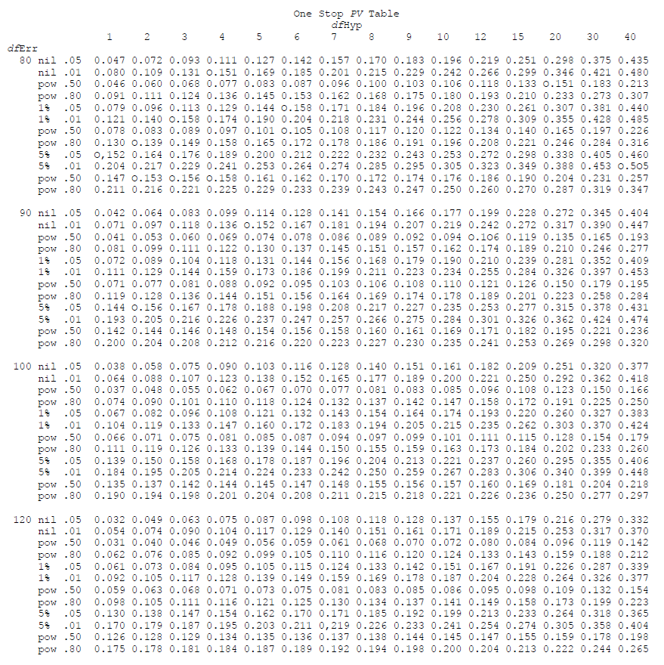
Minimum sample size needed (Appendix C)
Comparison to a Nil effect
The authors need a minimum sample size of 122 to have power of .80 with the effect they obtained.
Obtained R² = .07

Slide 13
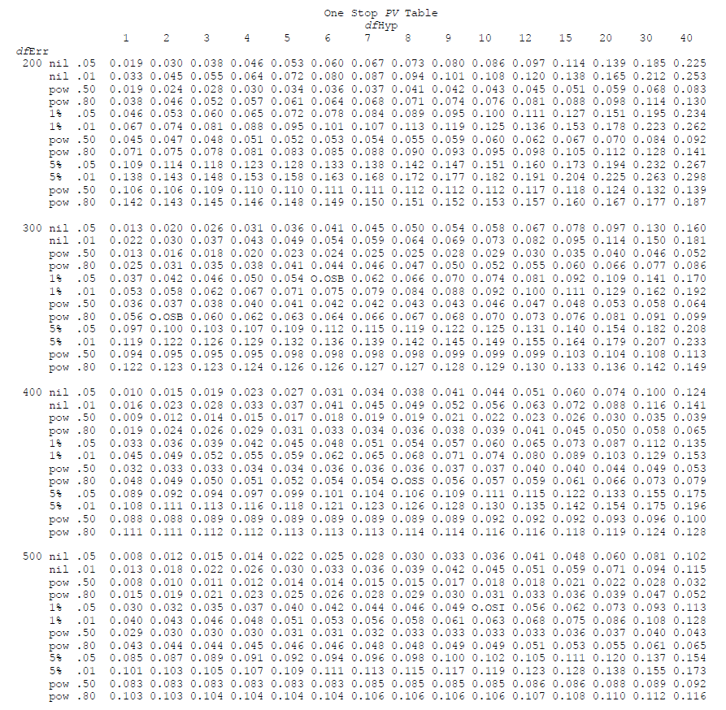
Minimum sample size needed (Appendix C)
Comparison to a 1% effect
The authors need a minimum sample size of 302 to have power of .80 with the effect they obtained.
Obtained R² = .07

Slide 14
Part 2: Practice with bayesian analyses

Slide 15
A quick introduction to bayesian statistics
Increasingly popular in psychology
Allows us to make probabilistic statements about events/hypotheses (tells us the probability of specific events given the observed data included in the analysis)
Models account for background knowledge (not discussed in detail in this lab)
May allow us to overcome several limitations of NHSTs (e.g., the reproducibility crisis in psychology and reliance on large sample sizes)
All common statistical analyses can be conducted in a bayesian framework (ANOVAs, regression, correlation, factor analysis, etc.)
Interpretations are often more concrete than significance tests (clear probability statements)
Note: While bayesian analyses are on the rise and may overcome several limitations of frequentist methods, use of classical statistics has been argued for as well (e.g., this NY Times article from 2014: https://www.nytimes.com/2014/09/30/science/the-odds-continually-updated.html?_r=1)

Slide 16
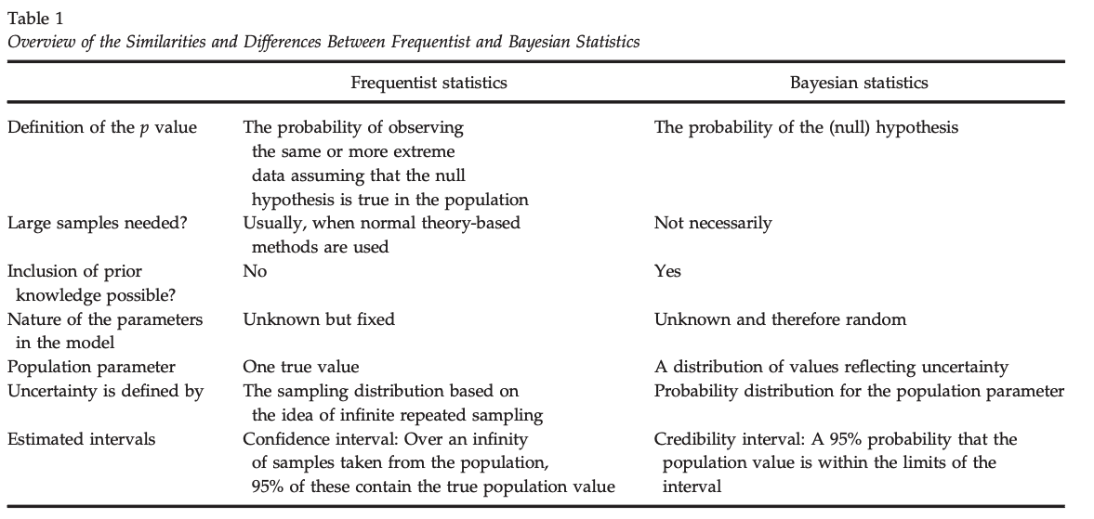
Compare bayesian and frequentist statistics
This table is from: Van de Schoot, R., Kaplan, D., Denissen, J., Asendorpf, J. B., Neyer, F. J., & Van Aken, M. A. (2014). A gentle introduction to Bayesian analysis: Applications to developmental research. Child development, 85(3), 842-860. https://www.ncbi.nlm.nih.gov/pmc/articles/PMC4158865/

Slide 17
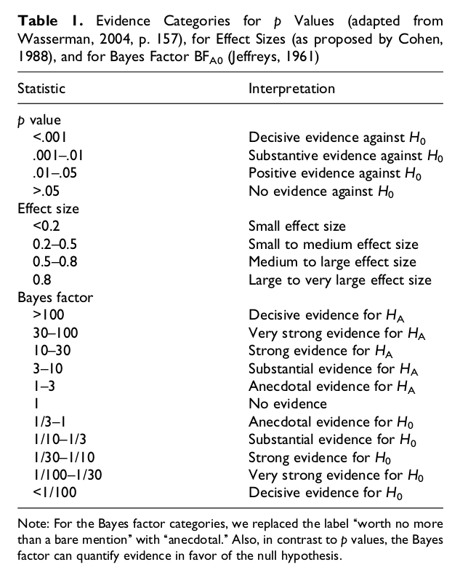
Rules of Thumb for Bayes Factor Interpretations
Bayes factors are indices of relative evidence of one model (or hypothesis) over another
Evidence for alternative hypothesis (compared to null hypothesis)
Evidence for null hypothesis (compared to alternative hypothesis)
Wetzels et al., 2011 https://journals.sagepub.com/doi/abs/10.1177/1745691611406923

Slide 18
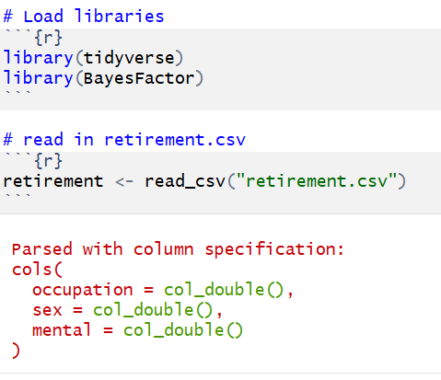
Load libraries and read in data
The retirement dataset has N=1910 for 3 variables:
Occupation: 1 = professor, 2 = manager, 3 = non manual worker, 4 = skilled worker, 5 = semi-skilled worker, 6 = unskilled worker
Sex: 1 = female, 2 = male
Mental: Continuous outcome variable indicating mental health (1-5)

Slide 19
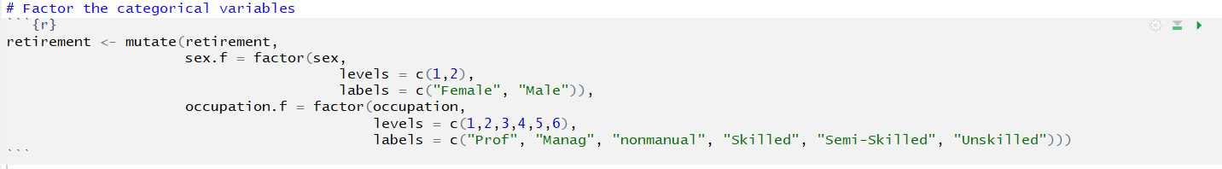
Factor the categorical variables
Tell R to read sex identity and occupation as categorical when conducting analyses

Slide 20
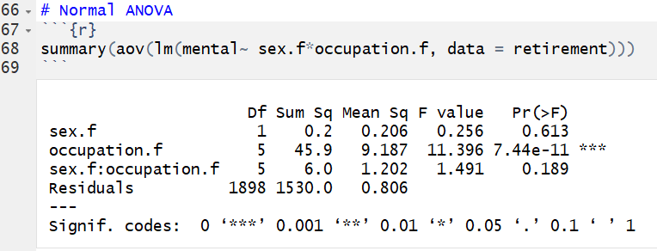
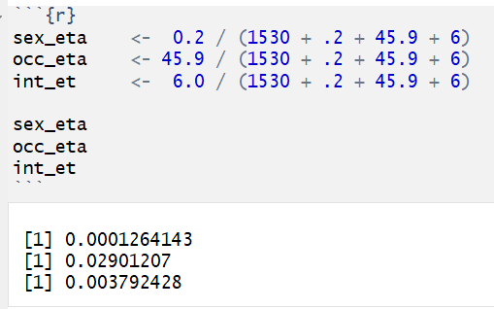
Conduct a regular ANOVA in which gender, occupation, and the interaction between the two predict mental health
Results indicate that only the main effect of occupation significantly predicts mental health.
This effect has the largest eta squared value, suggesting that occupation explains ~3% of the variance in mental health.

Slide 21
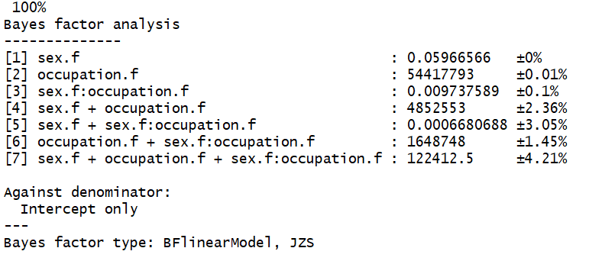
2) Conduct a bayesian ANOVA, starting with all models
Gives us the bayes factor for each possible model (i.e., all combinations of effects that we can test).
In this notation, a:b denotes an interaction term.

Slide 22
2) Conduct a bayesian ANOVA, starting with all models
Main takeaway:
Models that include occupation as a main effect have large bayes factors
BF > 100 = “decisive evidence for H_{A}”

Slide 23
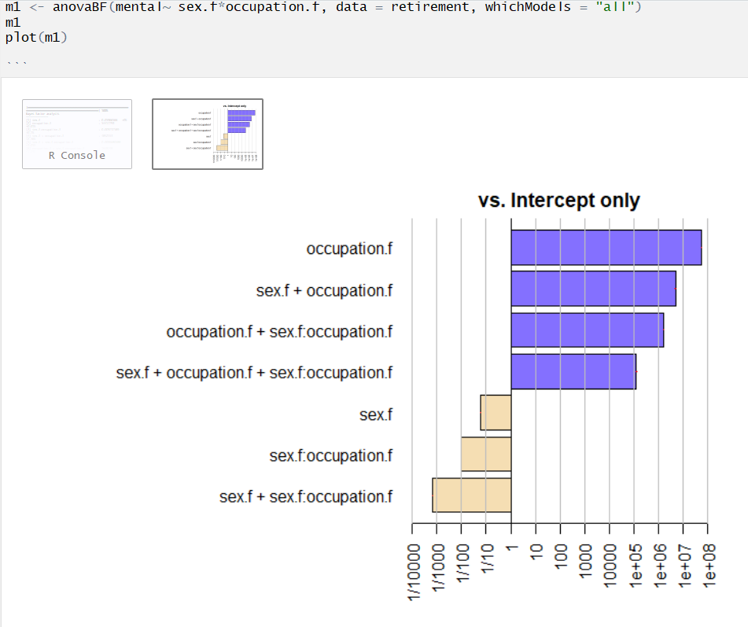
2a) Plot the bayes factor values for all models
Remember, a BF of 1 = no evidence for either the H_{A} or the H_{O}
= evidence for H_{A}
= evidence for H_{O}
y-axis = the models
x-axis = bayes factor (BF)

Slide 24
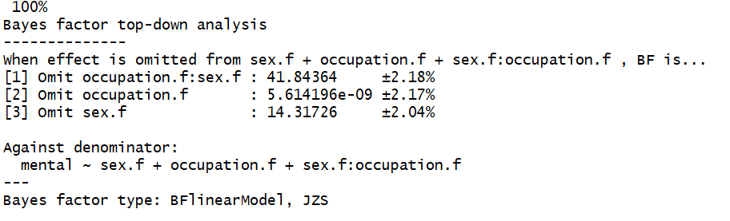
3) Conduct a bayesian ANOVA, using a “top-down” approach
Gives us the change in the model’s bayes factor when each effect is eliminated one at a time

Slide 25
3) Conduct a bayesian ANOVA, using a “top-down” approach
Main takeaway:
Removing occupation leaves a model with a very small bayes factor

Slide 26
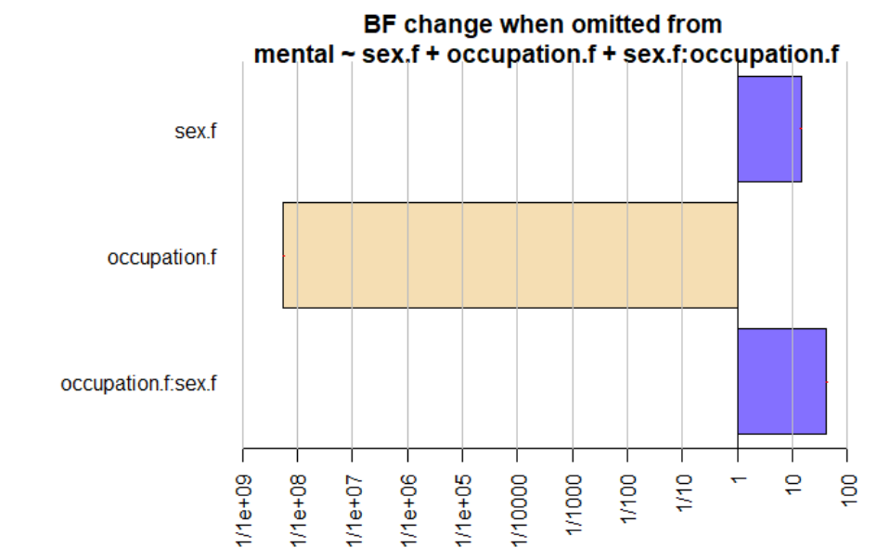
3a) Plot the change in bayes factor values for the “top-down” approach

Slide 27
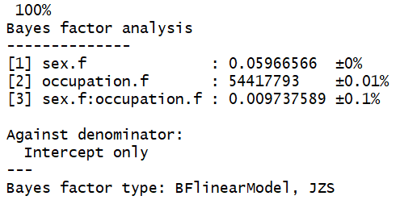
4) Conduct a bayesian ANOVA, using a “bottom-up” approach
Gives us the change in the model’s bayes factor when each effect is added one at a time

Slide 28
4) Conduct a bayesian ANOVA, using a “bottom-up” approach
Main takeaway:
Adding occupation increases the model’s bayes factor by a large amount

Slide 29
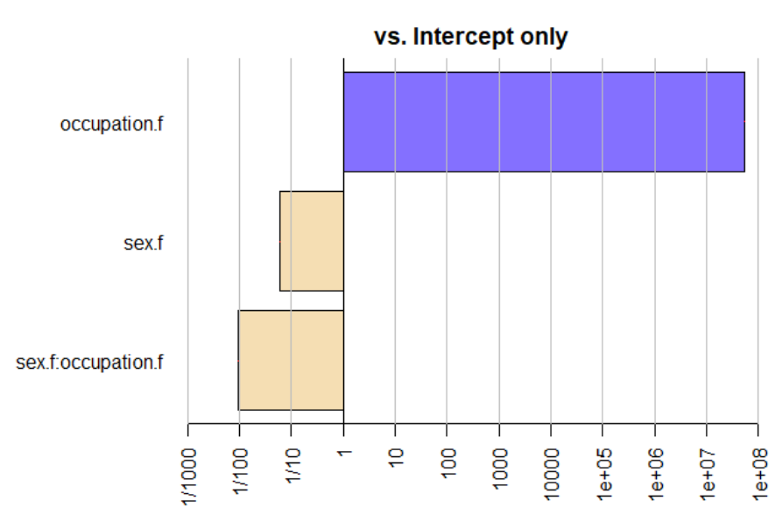
4a) Plot the change in bayes factor values for the “bottom-up” approach

Slide 30
Summary of results from the Bayesian analyses
All three bayesian analysis steps (“all models”, “top-down”, and “bottom-up”) support the same conclusion:
There is decisive evidence to support the hypothesis that occupation influences mental health.
There is strong evidence to support the null hypothesis that sex identity influences mental health (i.e., the null hypothesis, stating that gender does not predict mental health, is likely to be true).
There is decisive evidence to support the null hypothesis that the interaction between sex identity and occupation influences mental health (i.e., the null hypothesis is likely to be true).

Slide 31
Compare the regular ANOVA vs. Bayesian ANOVA
NHST ANOVA
Bayesian “all models” ANOVA
Both analyses indicate that occupation predicts mental health, while gender and gender*occupation do not.
The bayesian approach provides information that the frequentist approach does not:
degree of evidence for the null hypothesis
concrete statements about how well supported each model hypothesis is compared to the alternative hypothesis (e.g., null vs. alternative)

Slide 32
Additional resources on bayesian approaches
An article by Etz & Vandekerckhove (2018) about basic bayesian inferences. It opens with a quote by Dumbledore, so you know you want to read it! https://link.springer.com/article/10.3758/s13423-017-1262-3
Helpful tutorials for learning bayesian analyses using the BayesFactor package: https://richarddmorey.github.io/BayesFactor/#fixed
More great tutorials for getting started with bayesian analyses, this time from the BayestestR package: https://cran.r-project.org/web/packages/bayestestR/vignettes/bayestestR.html
The accompanying citation for the BayestestR package can be found at: https://www.theoj.org/joss-papers/joss.01541/10.21105.joss.01541.pdf
An example of using top down and bottom-up approaches with bayesian analyses: https://datascienceplus.com/bayesian-statistics-analysis-of-health-data/
An article by Krypotos et al. (2017) that calls for increased use of Bayesian approaches (and less NHST) in experimental psychology: https://journals.sagepub.com/doi/10.5127/jep.057316

